Slide 1
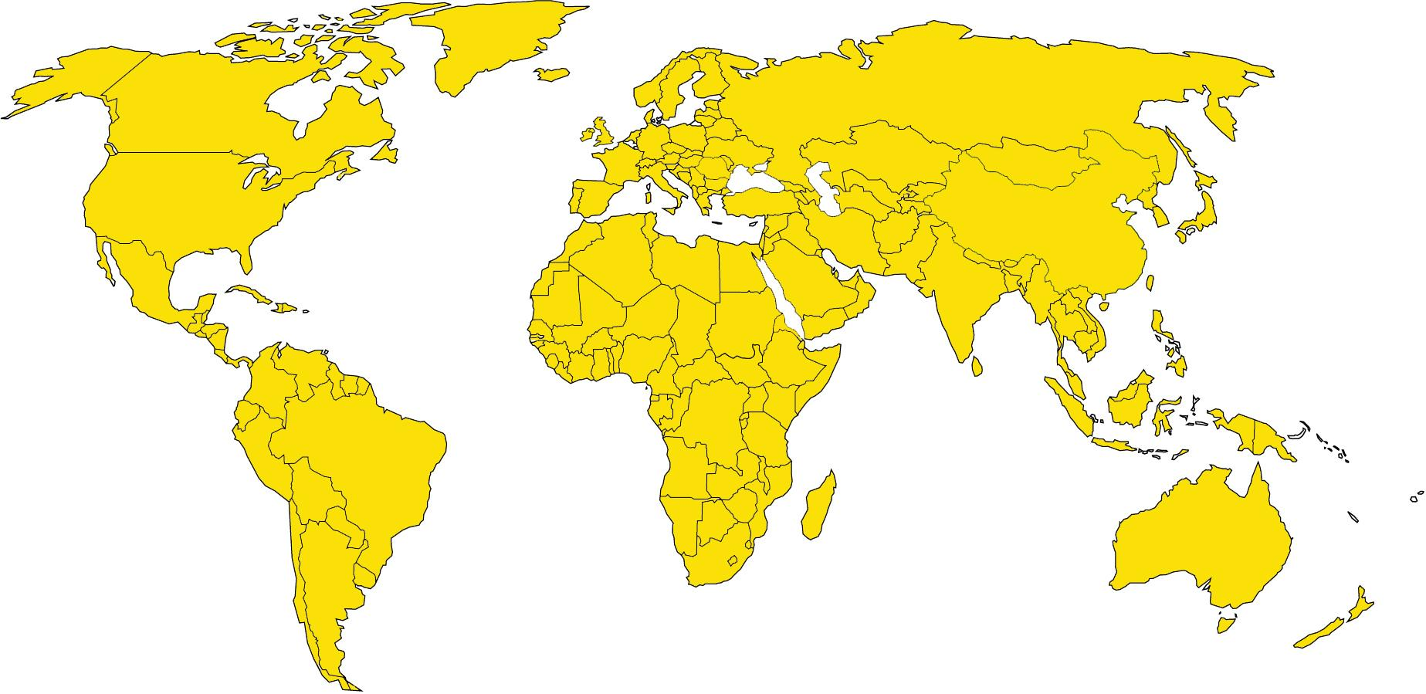
40-45 Million… what?

Slide 2
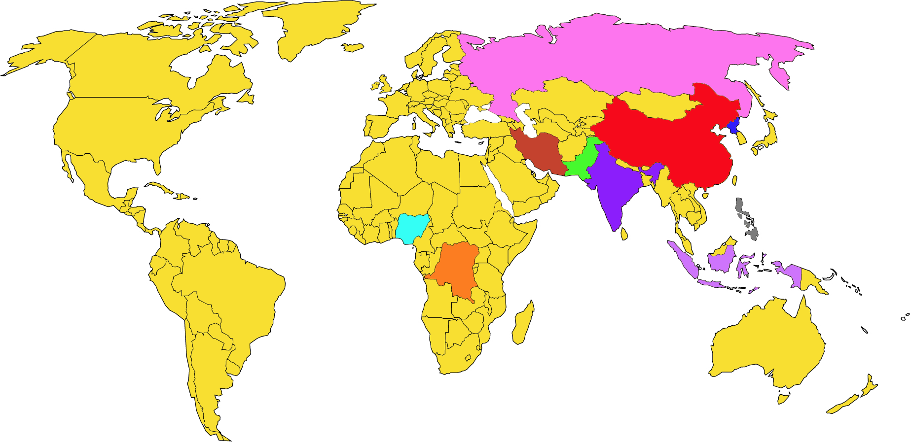
Top 10 - Highest number of Slaves (Raw Data)
India 7.9million
China 3.8million
Pakistan 3.2million
North Korea 2.6Million*
Nigeria 1.4million
Iran 1.3million
Indonesia 1.2million
Democratic Republic
of the Congo 1million
Russia 794,000
Philippines 784,000
Mark a cross on the countries with the highest number of slaves today

Slide 3
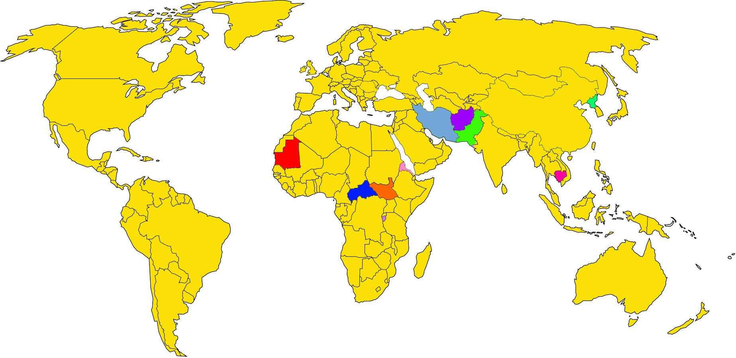
Top 10 - Highest Percentage % of Slaves
North Korea
Eritrea
Burundi
Central African Republic
Afghanistan
Mauritania
South Sudan
Pakistan
Cambodia
Iran
Mark a cross on the countries with the highest number of slaves as a percentage of their population. (Slaves per 1000 population)
Data from: https://www.globalslaveryindex.org/2018/data/maps/#prevalence

Slide 4
Which other countries is slavery found in today?
Mark a cross on the countries with slavery today

Slide 5
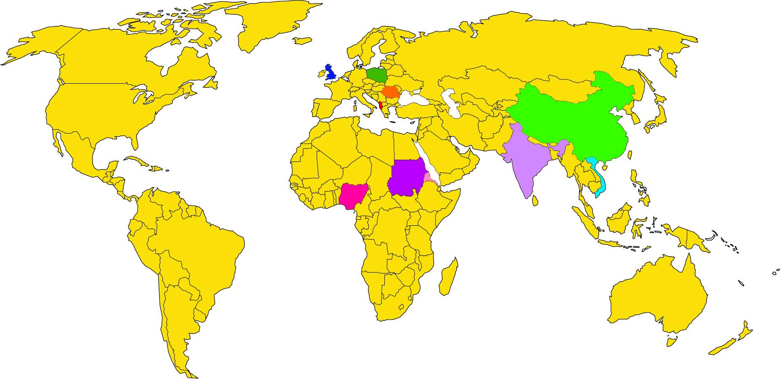
Top 10 - Nationalities of Slaves Held in the UK
United Kingdom
Albania
Vietnam
China
Nigeria
Romania
Sudan
Eritrea
India
Poland
Mark a cross on the top 10 Nationalities of SLaves in the UK Today
Data from: http://www.nationalcrimeagency.gov.uk/publications/national-referral-mechanism-statistics/2017-nrm-statistics/884-nrm-annual-report-2017/file

Slide 6
Optional
https://www.globalslaveryindex.org/2018/data/maps/#prevalence
Take some time to explore the global slavery index as a class.
What countries would be interesting to learn about?
Which countries have a good response to slavery? Is it enough?

